Slide 1
ROBO-V-MCU
Ethernet MAC integration
Progress So Far

Slide 2
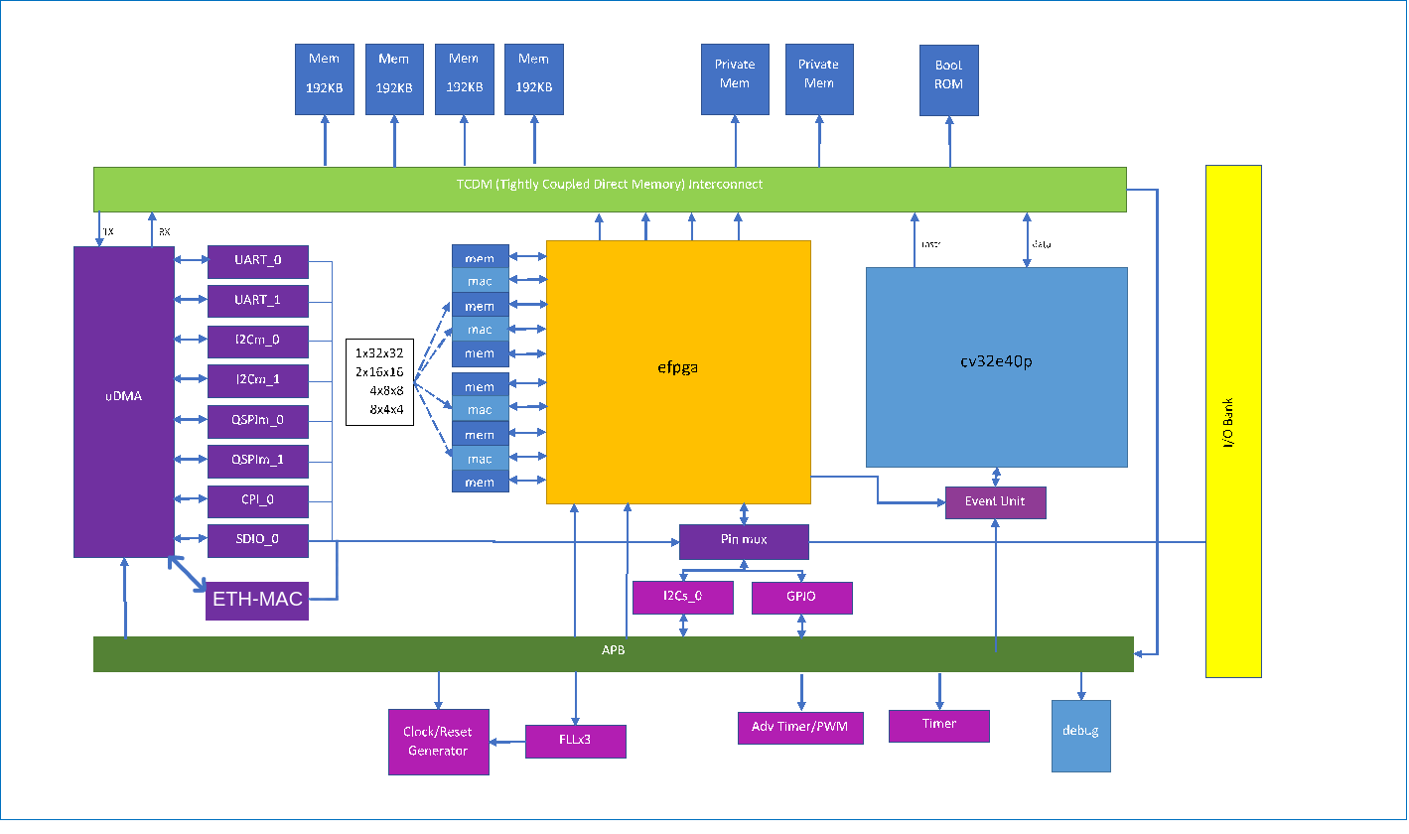
General Structure

Slide 3
Submodules
register interface – udma_ethernet_reg_if.sv
MAC-IP – rgmii_soc.sv
tx_controller – udma_eth_tx_controller
rx_controller – udma_eth_rx_controller
tx_buffer – eth_axis_tx_buffer
rx_buffer – eth_axis_rx_buffer

Slide 4
Module Structure
tx
controller
cfg_tx - data_tx
tx
buffer
register
interface
mac_ip
config and status
AXI-stream
RGMII
rx
buffer
rx
controller
cfg_rx - data_rx
sys_clock Domain
cross-clock Domain
125MHz RGMII clock Domain

